Slide 1


Troubleshooting SDN Control Software with Minimal Causal Sequences
Colin Scott, Andreas Wundsam, Barath Raghavan, Aurojit Panda, Andrew Or, Jefferson Lai, Eugene Huang, Zhi Liu, Ahmed El-Hassany, Sam Whitlock, Hrishikesh B. Acharya, Kyriakos Zarifis, Arvind Krishnamurthy, Scott Shenker
Notes:
Quick intro to SDN: this is a tech talk tomorrow at a startup that’s going to be adopting our system. They’re actually building production controllers, so the expectation is that they know this stuff. To anyone here who doesn’t know it: 15 second intro to SDN.
You’re welcome to interrupt me throughout

Slide 2
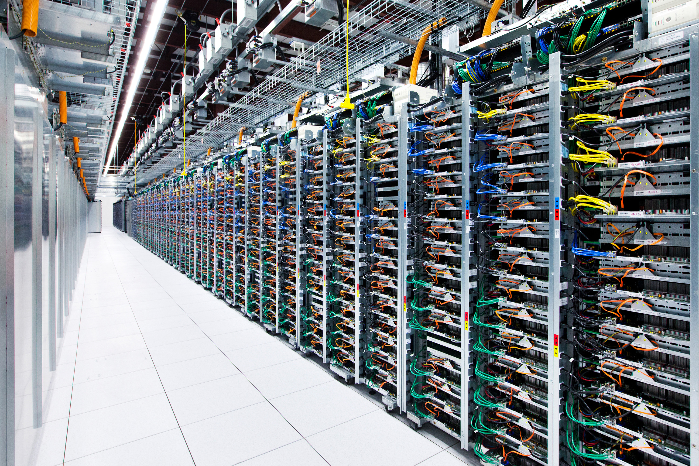

Slide 3
Something goes wrong!
Loops, Blackholes, etc. found in:
Unit tests
Integration tests
Software QA testbeds
Hardware QA testbeds
Production
Notes:
Describe what kinds of bugs these might be: loop, blackhole, breach of tenant isolation.

Slide 4
Best practice: Logs
Human analysis of log files
Notes:
From what I saw at Nicira and Google, the most common way to troubleshoot these problems is for a human to analyze log files.

Slide 5
Best practice: Logs
?
Controller A
Switch 1
Switch 2
Switch3
Controller B
Switch 4
Switch 5
Switch 6
Controller C
Switch 7
Switch 8
Switch 9

Slide 6

How many events?
20,000 servers * 4 VMs / server = 80,000 VMs
(6 migrations / day / VM) +
(2 power up|down / day / VM) *
80,000 VMs = 640,000 VM events / day
~= 450 VM changes / minute [1]
8.5 network error events / minute [2]

Slide 7
How many events?
= ~500 inputs / minute

Slide 8
Our Goal
Identify a minimal sequence of inputs that triggers the bug

Slide 9
Minimal Causal Sequence

Slide 10
Minimal Causal Sequence
Crash
Master
Ping
Pong
Ping
Backup
Master
Notify
Notify
ACK
Blackhole persists!
Switch
Link Failure
Notes:
Is Rob Vaterlaus in the room?

Slide 11
Minimal Causal Sequence
Master
Ping
Pong
Backup
New Routing Table!
Link Down!
Blackhole resolved!
Switch
Link Failure

Slide 12
Minimal Causal Sequence
Master
Crash
Ping
Pong
Ping
…
Backup
Master
Blackhole avoided!
Switch

Slide 13
Minimal Causal Sequence
Both are necessary conditions!
Master
Crash
Ping
Pong
Ping
Backup
Master
Notify
Notify
ACK
Blackhole persists!
Switch
Link Failure

Slide 14
Minimal Causal Sequence
?
Controller A
Switch 1
Switch 2
Switch3
Controller B
Switch 4
Switch 5
Switch 6
Controller C
Switch 7
Switch 8
Switch 9
Notes:
OK, so how are we going to get from here…

Slide 15
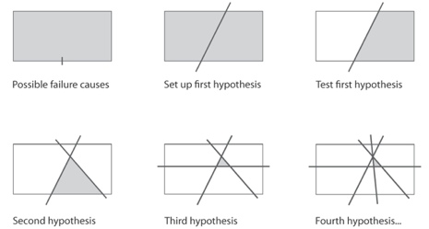
Approach: Delta Debugging
Modify history!
Notes:
Right now the cuts we make are based on time. But you could imagine doing this slicing based on nodes in the topology, or combinations of types of events.
If any of you are aware of the work, this technique is called delta debugging.
When you apply delta debugging to a distributed system rather than a single program, you run into some challenges.

Slide 16
Challenges
Replaying input events, in the face of
Asynchrony
Non-determinism
Divergent execution
Without assuming language or instrumentation of control software
Notes:
When you’re given a subsequence, you want to make sure you replay the bug, if possible.

Slide 17
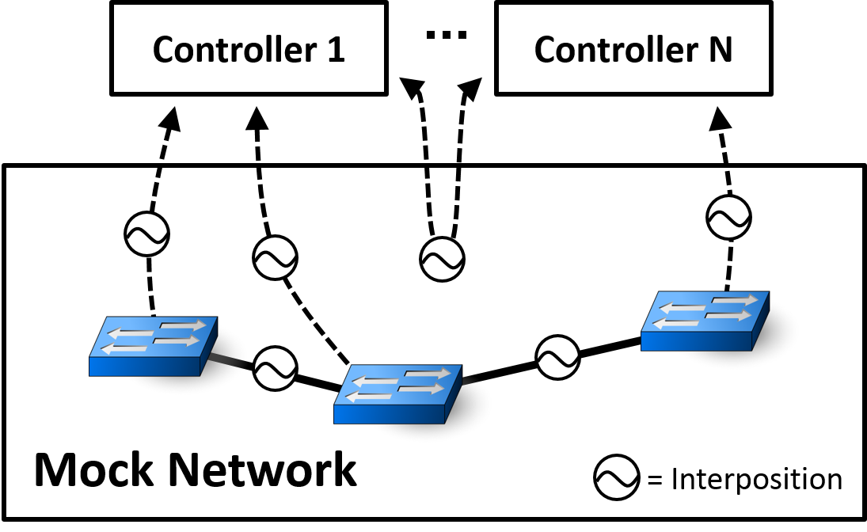
Replay Infrastructure
Notes:
We’re going to perform this replay by using the same infrastructure generate fuzz tests, and (ii) replay the resultant system execution.
If you were a company with a QA testbed, you would just need to add interposition. We built our own, since no open source were available for SDN

Slide 18
Replaying Pruned Inputs is Hard
Must consider internal events
Crash
Master
Ping
Ping
Pong
Timeout
Backup
Master
port_status
port_status
ACK
Blackhole persists!
Switch
Link Failure
Timeout

Slide 19
Replaying Pruned Inputs is Hard
Must consider internal events
Crash
Master
Ping
Ping
Pong
Timeout
Backup
New Routing Table!
Master
port_status
Blackhole avoided!
Switch
Link Failure

Slide 20
Pruning Alters Internal Events!
Prune Earlier Input..
Crash
Master
Ping
Seq=3
Pong
Seq=4
Ping
Seq=5
Timeout
Backup
Master
port_status
xid=12
port_status
xid=13
ACK
Switch
Link Failure
Timeout

Slide 21
Pruning Alters Internal Events!
Sequence Numbers Differ!
Crash
Master
Ping
Seq=2
Pong
Seq=3
Ping
Seq=4
Timeout
Backup
Master
port_status
xid=11
port_status
xid=12
ACK
Switch
Link Failure
Timeout

Slide 22
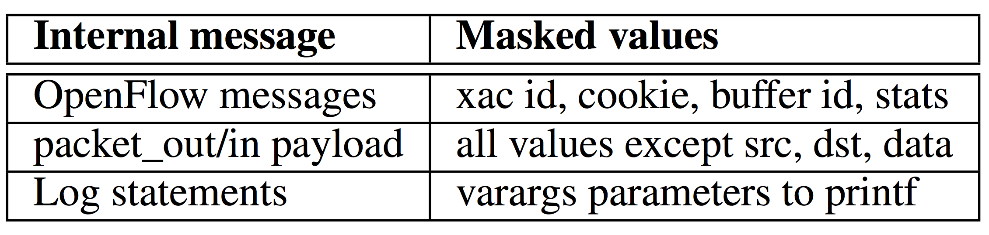
Solution: Equivalence Classes
Mask Over Extraneous Fields

Slide 23
Pruning Alters Internal Events!
Prune Earlier Input..
Crash
Master
Ping
Pong
Ping
Backup
Master
Notify
Notify
ACK
Switch
Link Failure
Notes:
Is Rob Vaterlaus in the room?

Slide 24
Pruning Alters Internal Events!
Some Events No Longer Appear
Crash
Master
Ping
Backup
Master
Notify
Notify
ACK
Switch
Link Failure
Notes:
Is Rob Vaterlaus in the room?

Slide 25
Solution: Peek ahead

Slide 26
Pruning Alters Internal Events!
Prune Input..
Master
Crash
Ping
Pong
Ping
…
Backup
Master
Switch

Slide 27
Pruning Alters Internal Events!
Unexpected Events Appear
Master
Crash
Ping
Pong
Ping
…
Backup
Master
LLDP
Switch

Slide 28
Dealing with unexpected events
Theory:
Divergent paths → Exponential possibilities
Practice:
Allow unexpected events through

Slide 29
Coping With Non-Determinism
Replay multiple times per subsequence
Probability of not finding bug modeled by:
Optionally override gettimeofday(), multiplex sockets, interpose on logging statements
Notes:
Hint: this is very small
Other tricks:
- multiplexed sockets
- override gettimeofday and rand
- interpose on logging library
- interpose on intra-controller messages

Slide 30
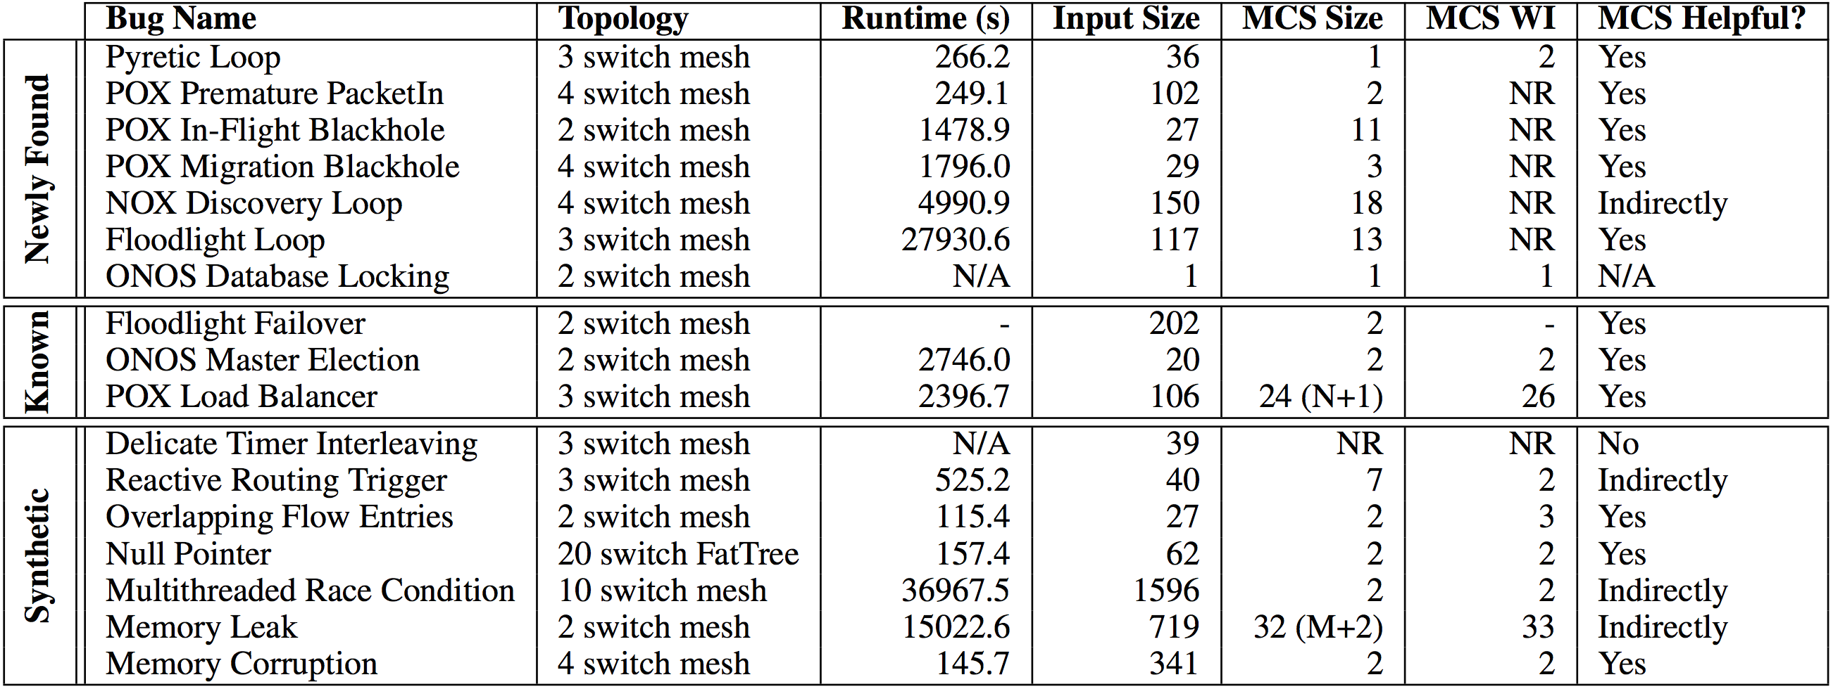
It Works!

Slide 31
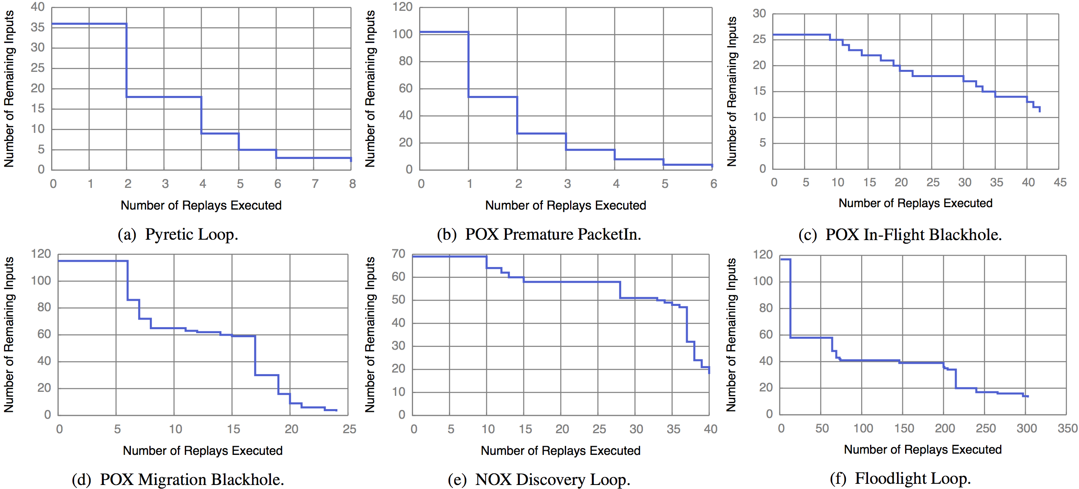
It Works!

Slide 32
Summary
Automatically isolate minimal causal sequences for distributed systems
System (23K+ lines of Python) evaluated on 6 SDN controllers (Floodlight, NOX, POX, Frenetic, ONOS) including one proprietary controller
ucb-sts.github.com/sts/

Slide 33
Ongoing work
Formal analysis of approach
Apply to other distributed systems (databases, consensus protocols)
Investigate effectiveness of various interposition points
Integrate STS into ONOS (ON.Lab) development workflow

Slide 34
References
[1] V. Soundararajan and K. Govil. Challenges in building scalable virtualized datacenter management. SIGOPS Operating Systems Review ’10.
[2] A. Greenberg, J. R. Hamilton, N. Jain, S. Kandula, C. Kim, P. Lahiri, D. A. Maltz, P. Patel, and S. Sengupta. VL2: a scalable and flexible data center network, Sec. 3.4. SIGCOMM ’09.

Slide 35
Backup

Slide 36
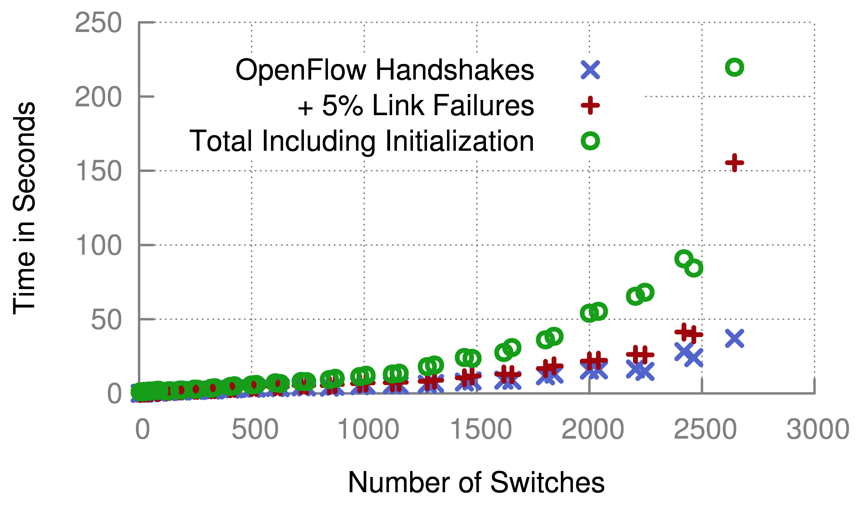
Scalability

Slide 37

Complexity
Best Case | Worst Case
Delta Debugging: (log n) replays Each replay: O(n) events Total: (nlog n) | Delta Debugging: O(n) replays Each replay: O(n) events Total: O(n²)
Notes:
Key issue is not complexity, it’s running in parallel overnight. Reduce dev time at all costs!
Optimizations:
- can be parallelized
Can take periodic snapshots
Causal annotations

Slide 38
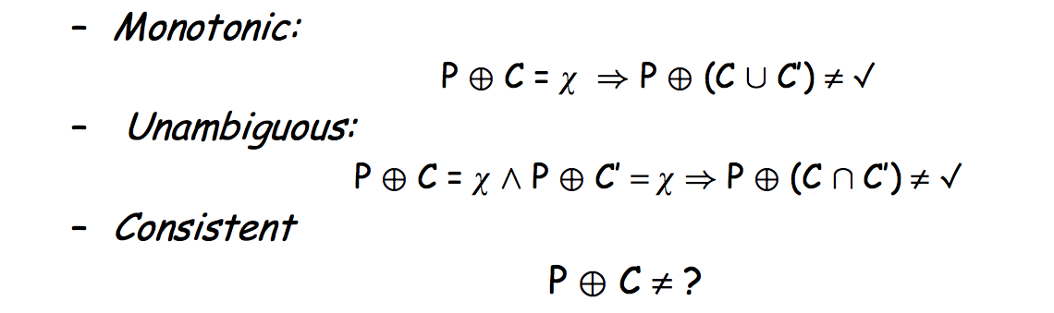
Assumptions of Delta Debugging

Slide 39
Coping With Non-determinism
Results for synthetic multithreading bug in Floodlight

Slide 40
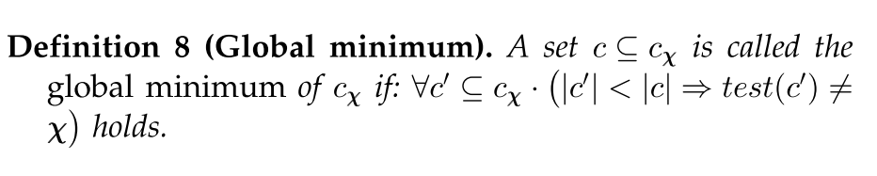
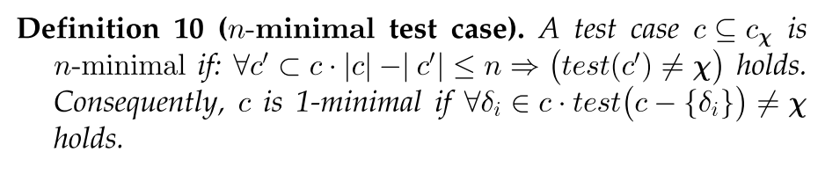
Local vs. Global Minimality

Slide 41
Forensic Analysis of Production Logs
Logs need to capture causality: Lamport Clocks or accurate NTP
Need clear mapping between input/internal events and simulated events
Must remove redundantly logged events
Might employ causally consistent snapshots to cope with length of logs

Slide 42
Related Work
Delta Debugging
Program Flow Analysis
Instrumentation (Tracing)
Bug Detection (Invariant Checking, Model Checking)
Replay
Root Cause Analysis

Slide 43
Instrumentation Complexity
Code to override gettimeofday(), interpose on logging statements, and multiplex sockets:
415 LOC for POX (Python)
722 LOC for Floodlight (Java)

Slide 44
Improvements
Many improvements:
Parallelize delta debugging
Smarter delta debugging time splits
Apply program flow analysis to further prune
Compress time (override gettimeofday)

